Slide 1
Internet of Things
Dr. Phanindra Thota

Slide 2
Unit-5
Case Study & Industrial Applications

Slide 3
Architecture
Components
Vehicular IoT
Architecture
Healthcare IoT
Architecture
Advantages
Components
Advantages
Components
Advantages & Risk
Agricultural IoT

Slide 4
Components in Various IoT Systems
Agricultural IoT | Vehicular IoT | Healthcare IoT
Sensor | Sensor | Sensor
Satellite | Satellite | Privacy and security
Wireless connectivity | Wireless connectivity | Wireless connectivity
Cloud and for computing | Cloud and for computing | Cloud and for computing
Analytics | Analytics | Analytics
Handheld device | Road side unit (RSU) | Interface
Drone & Camera

Slide 5
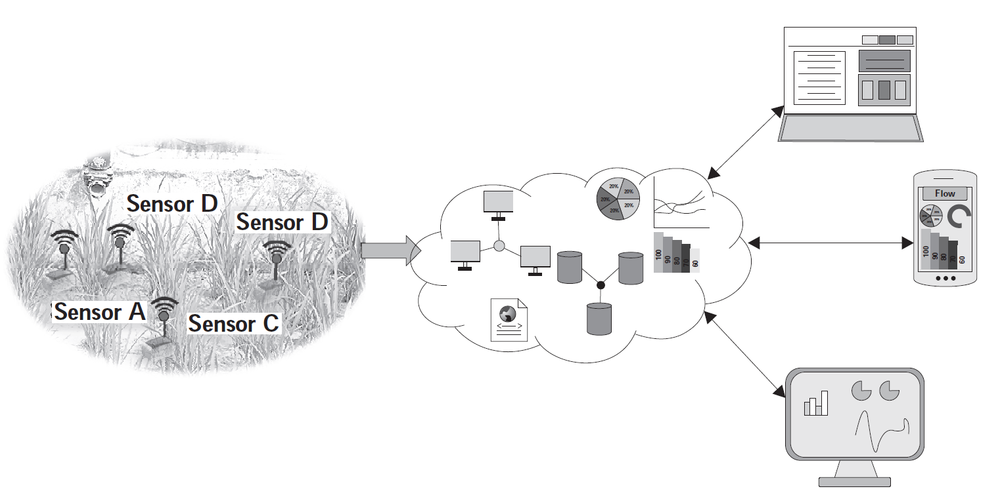
Architecture of agricultural IoT
Agricultural services
Server / Cloud
Sensors

Slide 6
In an IoTbased agricultural system, different sensors necessarily have to be deployed over agricultural fields, and the sensed data from these sensors need to be transmitted to a centralized entity such as a server, cloud, or fog devices. Further, these data have to be processed and analyzed to provide various agricultural services. Finally, a user should be able to access these services from handheld devices or computers.

Slide 7
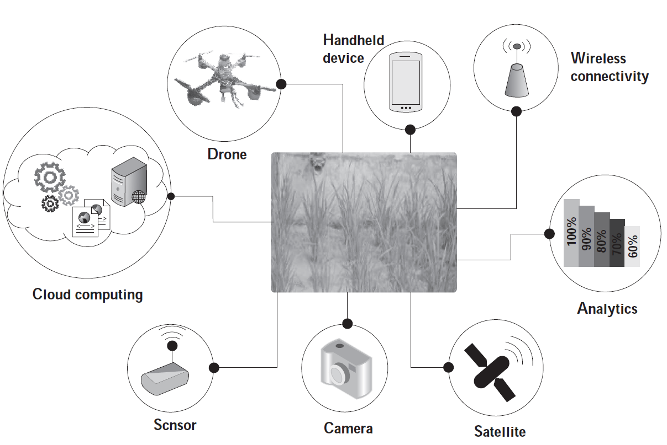
Components of agricultural IoT

Slide 8
Cloud computing: Sensors such as the camera, devices to measure soil moisture, soil humidity, and soil pH-level are used for serving different agricultural applications. These sensors produce a huge amount of agricultural data that need to be analyzed. Sometimes, based on the data analysis, action needs to be taken, such as switching on the water pump for irrigation. Further, the data from the deployed sensors are required to be stored on a long-term basis since it may be useful for serving future applications. Thus, for agricultural data analysis and storage, the cloud plays a crucial role.
Sensors: We have seen that the sensors are the major backbone of any IoT application. Similarly, for agricultural IoT applications, the sensors are an indispensable component. A few of the common sensors used in agriculture are sensors for soil moisture, humidity, water level, and temperature.
Cameras: Imaging is one of the main components of agriculture. Therefore, multispectral, thermal, and RGB cameras are commonly used for scientific agricultural IoT. These cameras are used for estimating the nitrogen status, thermal stress, water stress, and crop damage due to inundation, as well as infestation. Video cameras are used for crop security.

Slide 9
Satellites: In modern precision agriculture, satellites are extensively used to extract information from field imagery. The satellite images are used in agricultural applications to monitor different aspects of the crops such as crop health monitoring and dry zone assessing over a large area.
Analytics: Analytics contribute to modern agriculture massively. Currently, with the help of analytics, farmers can take different agricultural decisions, such as estimating the required amount of fertilizer and water in an agricultural field and estimating the type of crops that need to be cultivated during the upcoming season. Moreover, analytics is not only responsible for making decisions locally; it is used to analyze data for the entire agricultural supply chain. Data analytics can also be used for estimating the crop demand in the market.

Slide 10
Wireless connectivity: One of the main components of agricultural IoT is wireless connectivity. Wireless connectivity enables the transmission of the agricultural sensor data from the field to the cloud/server. It also enables farmers to access various application services over handheld devices, which rely on wireless connectivity for communicating with the cloud/server.
Handheld devices: Over the last few years, e-agriculture has become very popular. One of the fundamental components of e-agriculture is a handheld device such as a smartphone. Farmers can access different agricultural information, such as soil and crop conditions of their fields and market tendency, over their smartphones. Additionally, farmers can also control different field equipment, such as pumps, from their phones.

Slide 11
Advantages of IoT in agriculture
Automatic seeding
Efficient fertilizer and pesticide distribution
Water management
Real-time and remote monitoring
Easy yield estimation
Production overview

Slide 12
Case Study : Smart irrigation management system
In precision agriculture, the regular monitoring of different agricultural parameters, such as water level, soil moisture, fertilizers, and soil temperature are essential.
Moreover, for monitoring these agricultural parameters, a farmer needs to go to his/her field and collect the data. Excess water supply in the agricultural field can damage the crops.
On the other hand, insufficient water supply in the agricultural field also affects the healthy growth of crops. Thus, efficient and optimized water supply in the agricultural field is essential.
The primary objective of this system is to provide a Web-based platform to the farmer for managing the water supply of an irrigated agricultural field.
The system is capable of providing a farmer-friendly interface by which the field condition can be monitored. With the help of this system, a farmer can take the necessary decision for the agricultural field based on the analysis of the data.

Slide 13
However, the farmer need not worry about the complex background architecture of the system.
It is an affordable solution for the farmers to access the agricultural field data easily and remotely.
The architecture of this system consists of three layers:
Sensing and actuating layer
Remote processing and service layer
Application layer.
These layers perform dedicated tasks depending on the requirements of the system.

Slide 14
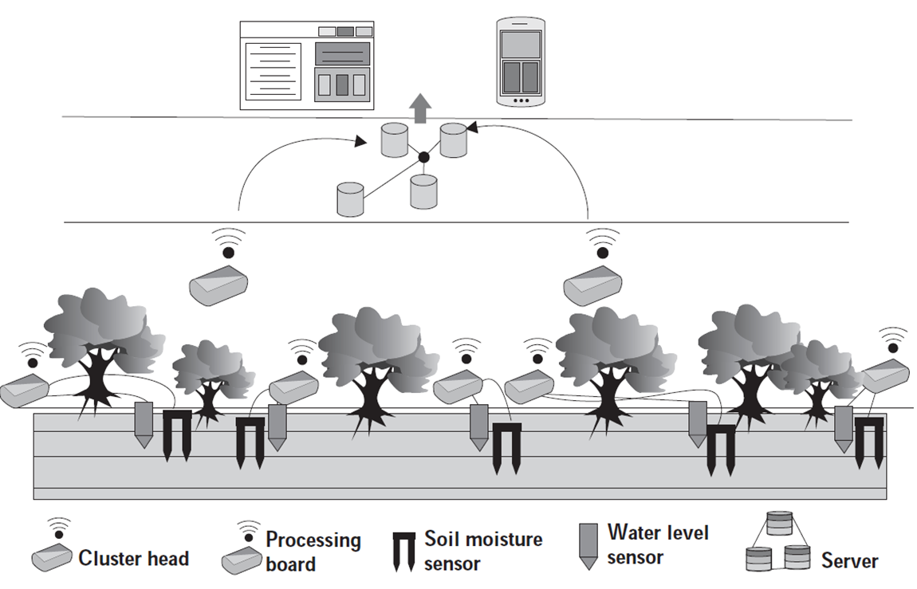

Slide 15
1. Sensing and Actuating layer: This layer deals with different physical devices, such as sensor nodes, actuators, and communication modules. In the system, a specially designated sensor node works as a cluster head to collect data from other sensor nodes, which are deployed on the field for sensing the value of soil moisture and water level.
A cluster head is equipped with two communication module: ZigBee (IEEE 802.15.4) and General Packet Radio Service (GPRS). The communication between the deployed sensor nodes and the cluster head takes place with the help of ZigBee. Further, the cluster heads use GPRS to transmit data to the remote server.
An electrically erasable programmable read-only memory (EEPROM), integrated with the cluster head, stores a predefined threshold value of water levels and soil moisture. When the sensed value of the deployed sensor node drops below this predefined threshold value, a solenoid (pump) activates to start the irrigation process. In the system, the standard EC-05 soil moisture sensor is used along with the water level sensor, which is specifically designed and developed for this project.

Slide 16
2. Processing and Service layer: This layer acts as an intermediate layer between the sensing and actuating layer and the application layer. The sensed and process data is stored in the server for future use. Moreover, these data are accessible at any time from any remote location by authorized users. Depending on the sensed values from the deployed sensor nodes, the pump actuates to irrigate the field.
3. Application layer: The farmer can access the status of the pump, whether it is in switch on/off, and the value of different soil parameters from his/her cell phone. This information is accessible with the help of the integrated GSM facility of the farmers’ cell phone. Additionally, an LED array indicator and LCD system is installed in the farmers’ house. Using the LCD and LED, a farmer can easily track the condition of his respective fields. Apart from this mechanism, a farmer can manually access field information with the help of a Web-based application. Moreover, the farmer can control the pump using his/her cell phone from a remote location.

Slide 17
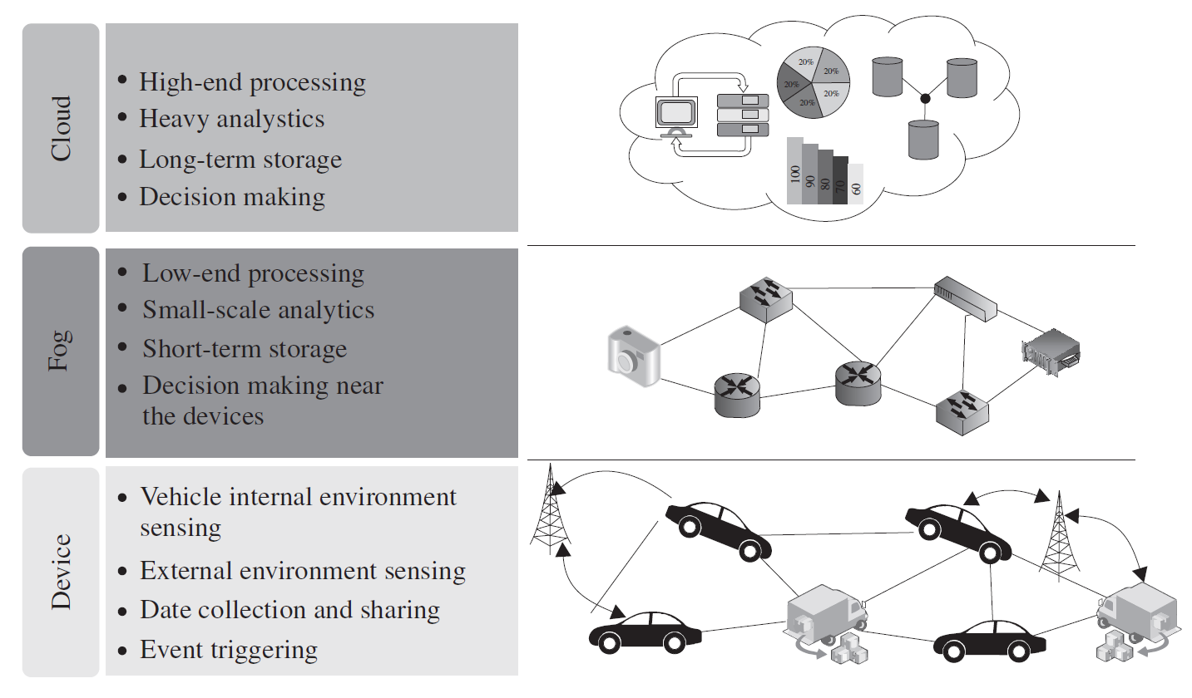
Architecture of vehicular IoT

Slide 18
The architecture of the vehicular IoT is divided into three sublayers: device, fog, and cloud.
• Device: The device layer is the bottom-most layer, which consists of the basic infrastructure of the scenario of the connected vehicle. This layer includes the vehicles and road side units (RSU). These vehicles contain certain sensors which gather the internal information of the vehicles. On the other hand, the RSU works as a local centralized unit that manages the data from the vehicles.
• Fog: In vehicular IoT systems, fast decision making is pertinent to avoid accidents and traffic mismanagement. In such situations, fog computing plays a crucial role by providing decisions in real-time, much near to the devices. Consequently, the fog layer helps to minimize data transmission time in a vehicular IoT system.
• Cloud: Fog computing handles the data processing near the devices to take decisions instantaneously. However, for the processing of huge data, fog computing is not enough. Therefore, in such a situation, cloud computing is used. In a vehicular IoT system, cloud computing helps to handle processes that involve a huge amount of data. Further, for long-term storage, cloud computing is used as a scalable resource in vehicular IoT systems.
Notes:
Fog computing is a distributed computing architecture that places data storage and computation closer to the network's edge, where many IoT devices are located.

Slide 19
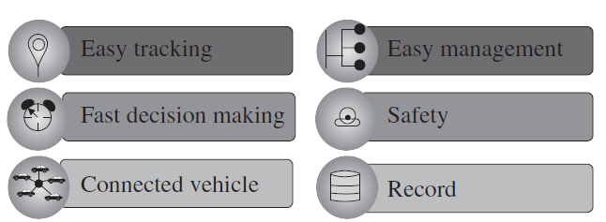
Advantages of vehicular IoT

Slide 20
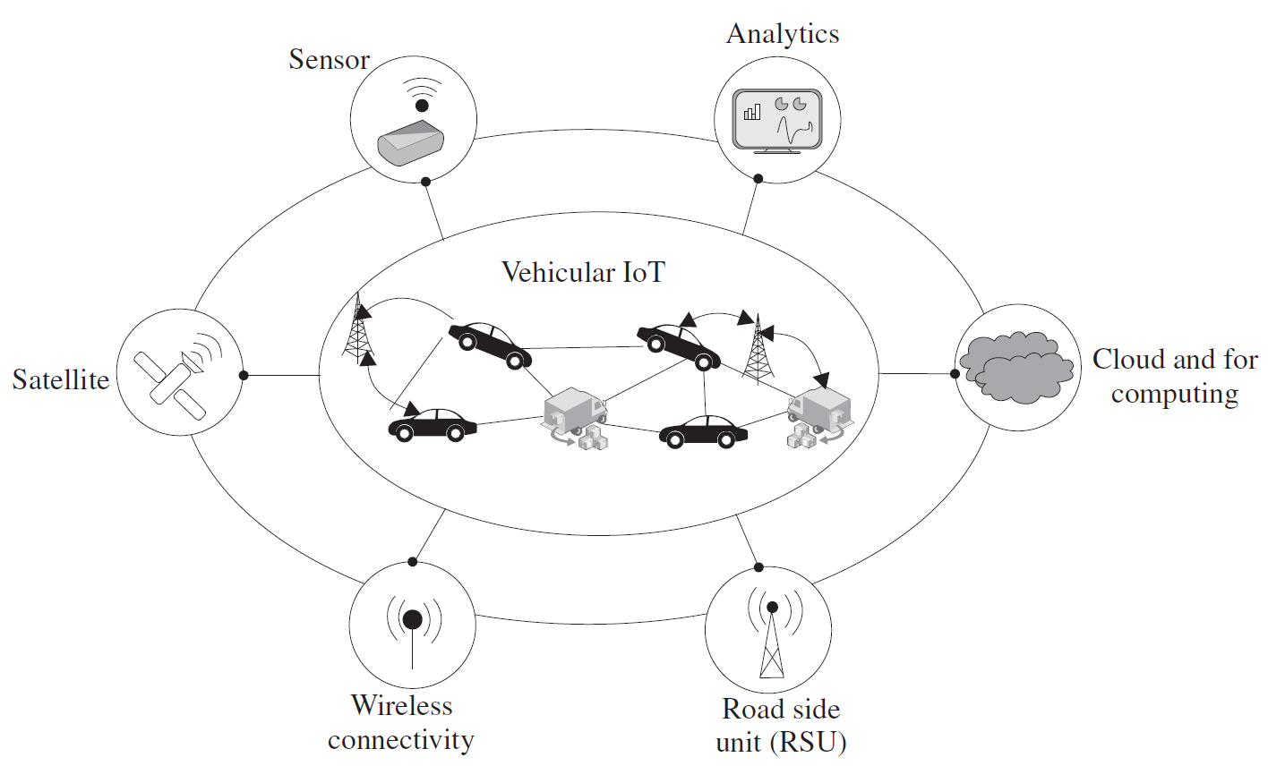
Components of Vehicular IoT

Slide 21
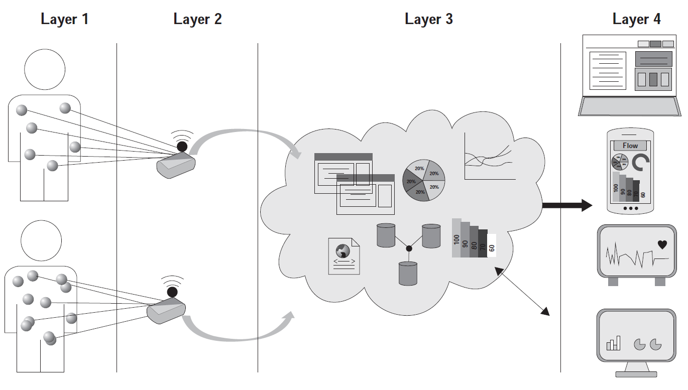
Architecture of healthcare IoT

Slide 22
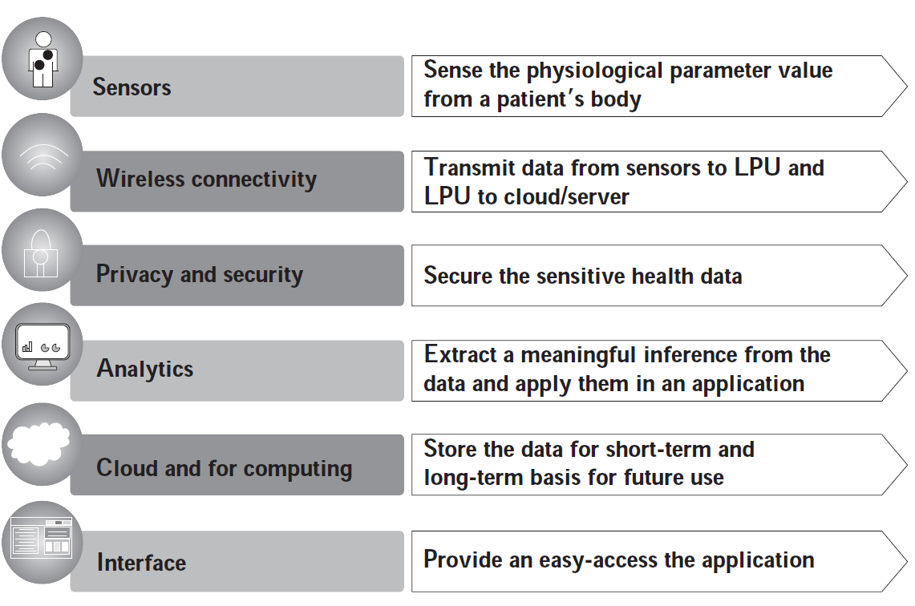
Components of healthcare IoT

Slide 23
